Slide 1
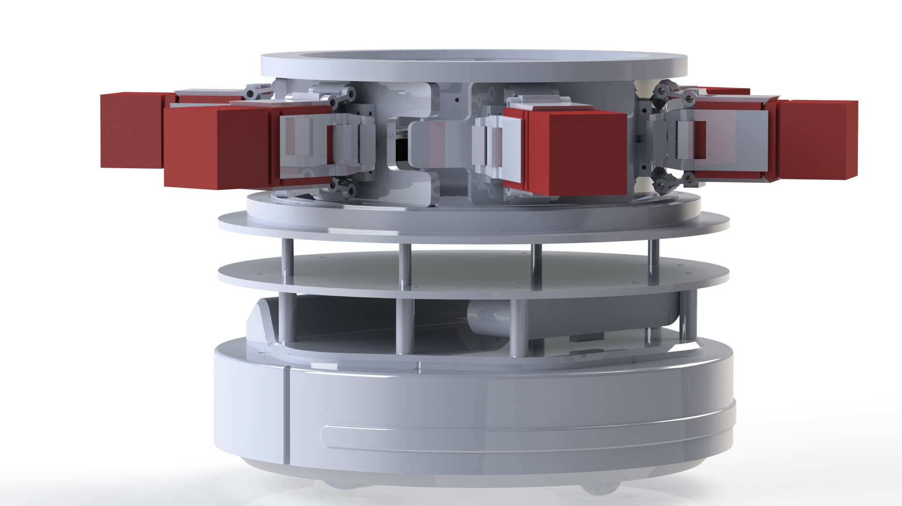
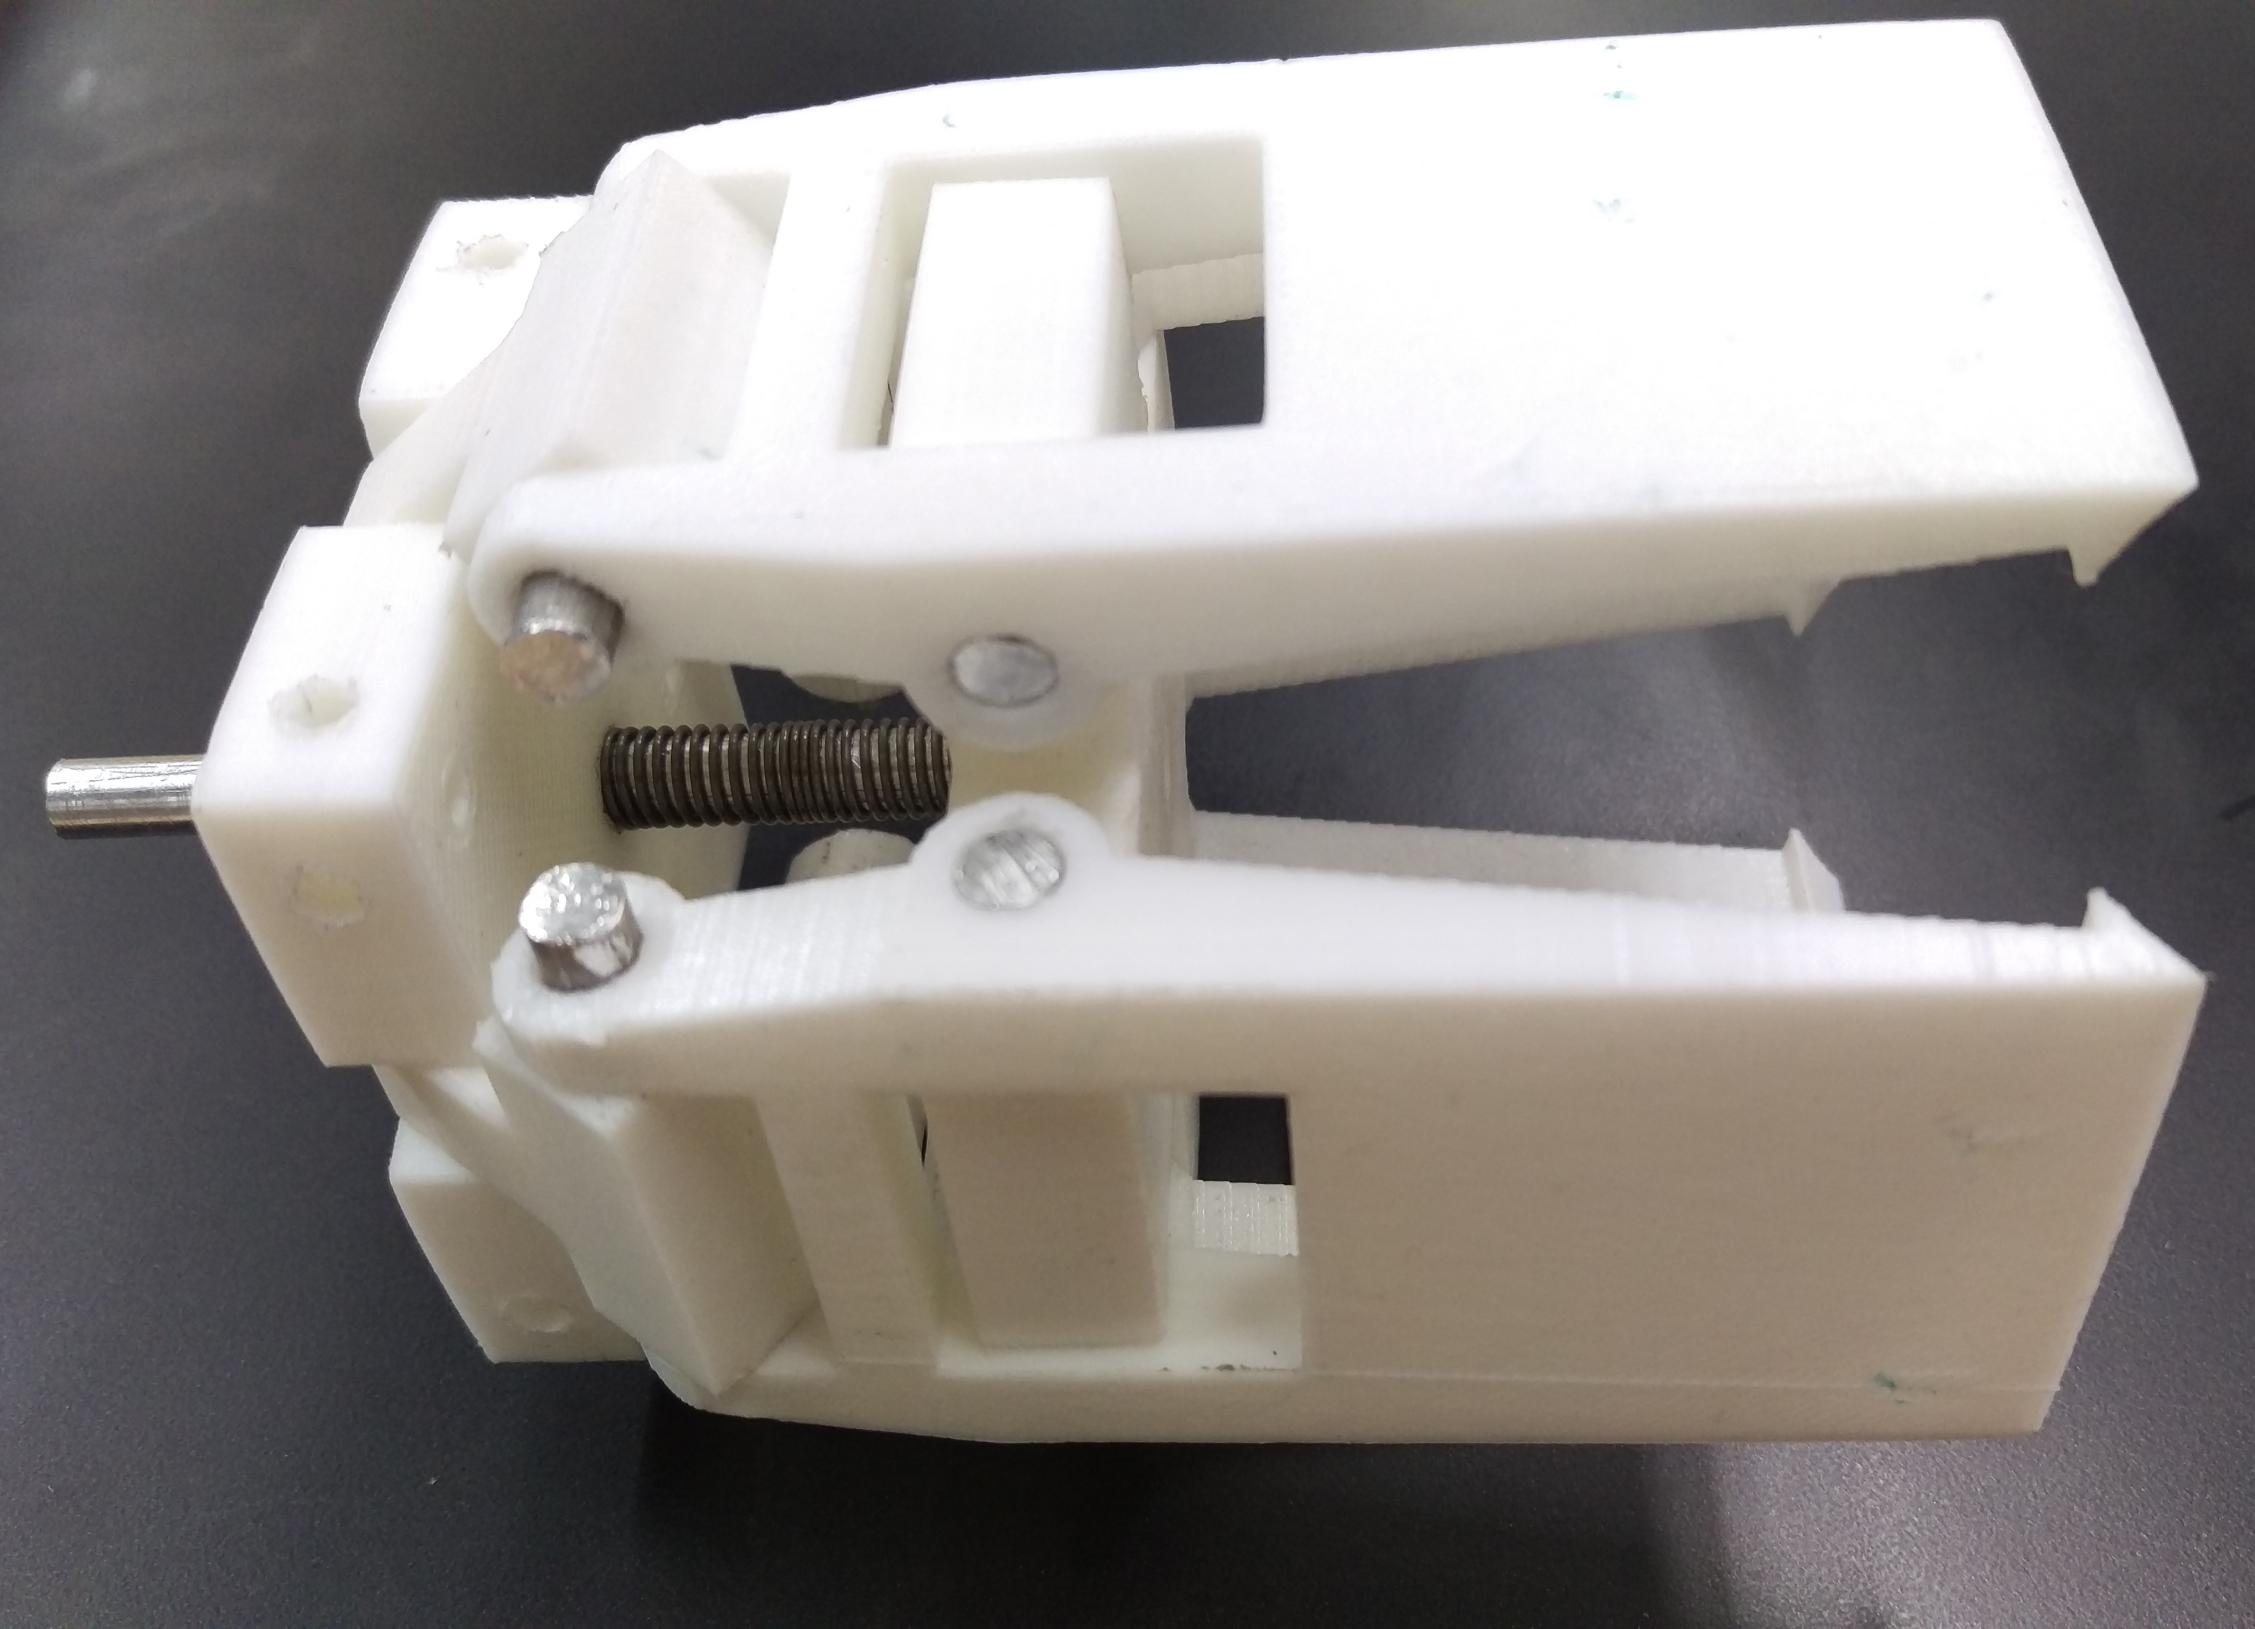
Minor robot logistics
Decentralized control
Remco Aarts, Jeroen van den Akker, Robert Delmaar, Bas Janssen,
Addie Perenboom, Dimitri Waard
Introduction
This is a 14 week project from the minor Adaptive Robotics. The goal is to create an industry 4.0 environment by using Turtlebots to transport products. The decision-making in this project is decentralized, meaning each robot makes its own decisions based on information that is exchanged between them.
Figure 1 – The mechanical design
Hardware
The hardware for this project was designed using a morphological map which detailed every requirement of the system.
To make the transfer of products easier, a carriage is used. By doing this the gripper could be designed to handle 1 shape perfectly, instead of having to be able to adjust to different products.
Figure 2 – The gripper
Software
Simulations
Scales to more robots
Decision calculation
References
Blasdel, A., Leeper, A., & Hendrix, A. (z.j.). Robot operating system. Geraadpleegd van http://ros.org/
Debiec, J. (z.j.). Running ROS across multiple machines. Geraadpleegd van http://wiki.ros.org/ROS/Tutorials/MultipleMachines
Tiderko, A. (z.j.). multimaster fkie. Geraadpleegd van https://github.com/ fkie/multimaster fkie
Hsu, J., Koenig, N., & Coleman, D. (n.d.). gazebo ros pkgs. Retrieved from http://wiki.ros.org/gazebo ros pkgs
Jagielka, J. (z.j.). Multiple robots simulation and navigation. Geraadpleegd van http://answers.ros.org/question/41433/ multiple-robots-simulation-and-navigation/
Gerkey, B. (z.j.). Slam gmapping. Geraadpleegd van https://github.com/ ros-perception/slam gmapping
Natterer, M., & Neumann, S. (z.j.). GNU IMAGE MANIPULATION PROGRAM. Geraadpleegd van https://www.gimp.org/
Correspondence to: Robert Delmaar r.delmaar.student@student.fontys.nl

